Slide 1
Decision Tree Classification - Cart

Slide 2

Example of Decision tree for a car driving:
KEEP DRIVING FORWARD
YES
IS THERE A STOP LIGHT AHEAD?
IS THE STOP LIGHT RED?
NO
NO
FIND A PETROL STATION, AND BUY GAS/PETROL
YES
YES
NO
IS THERE ENOUGH GAS/PETROL IN THE CAR?
KEEP GOING
STOP

Slide 3
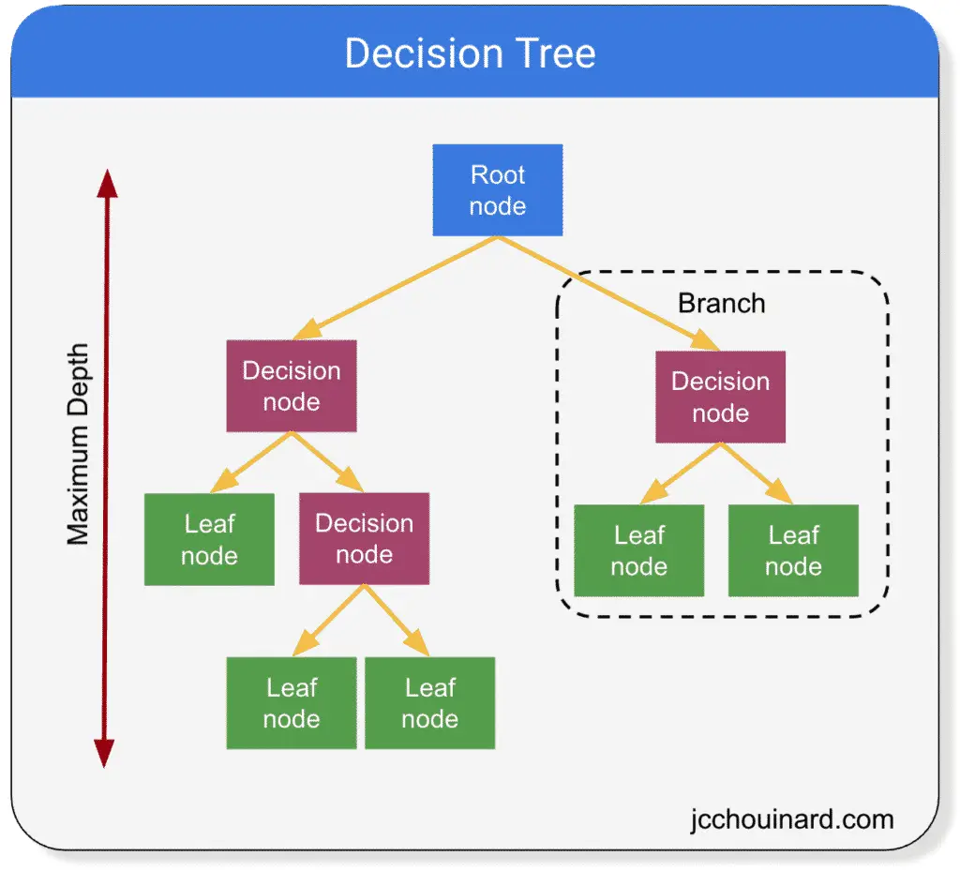
Decision Tree is a Supervised learning technique that can be used for both classification and Regression problems.
It builds a model in the form of a tree structure.
A decision tree consists of three types of nodes:
Root Node
Branch Node
Leaf Node

Slide 4
CART (Classification and Regression Tree)
It is used for generating both classification tree and regression tree.
It uses Gini index as metric/cost function to evaluate split in feature selection in case of classification tree.
It is used for binary classification.
It use least square as a metric to select features in case of Regression tree.

Slide 5
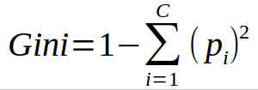
Gini Index:
Gini index is a metric for classification tasks in CART
It stores sum of squared probabilities of each class.
It has value between 0 and 1.
Gini Index works with the categorical target variable “Yes” or “No”. It performs only Binary splits.
Lesser the value of Gini index higher of homogeneity.

Slide 6
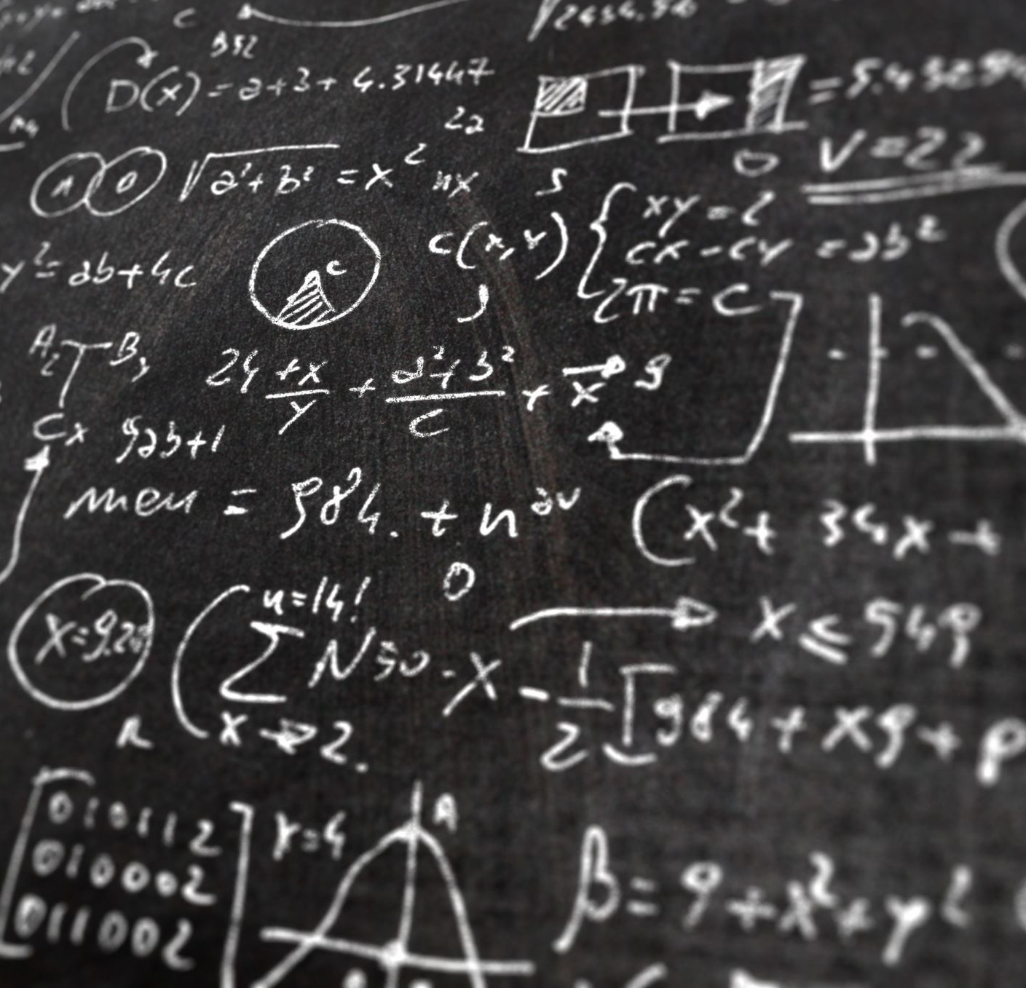
MATH BEHIND DECISION TREE :

Slide 7
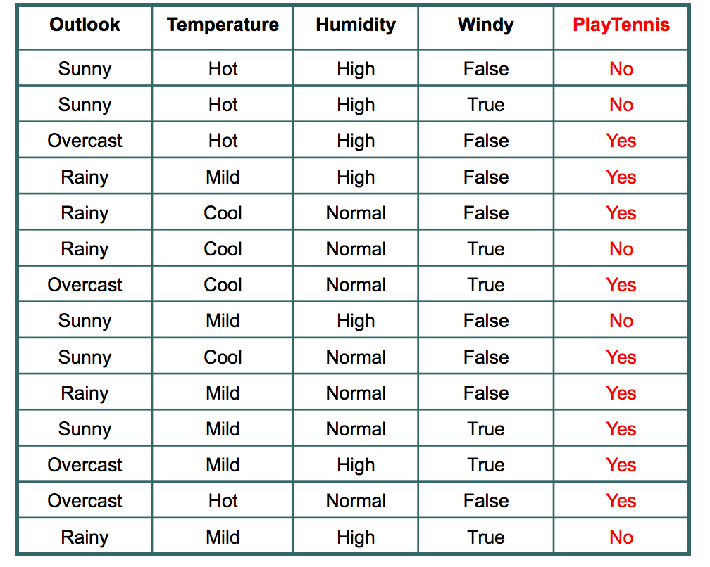
Dataset: There are 14 instances of golf playing decisions based on outlook, temperature, humidity and wind factors.

Slide 8
OUTLOOK:
OUTLOOK | YES | NO | NO OF INSTANCES
SUNNY | 2 | 3 | 5
OVERCAST | 4 | 0 | 4
RAINFALL | 3 | 2 | 5
Gini(Outlook=Sunny) = 1 – (2/5)² – (3/5)² = 1 – 0.16 – 0.36 = 0.48
Gini(Outlook=Overcast) = 1 – (4/4)² – (0/4)² = 0
Gini(Outlook=Rain) = 1 – (3/5)² – (2/5)² = 1 – 0.36 – 0.16 = 0.48
Gini(Outlook) = (5/14) x 0.48 + (4/14) x 0 + (5/14) x 0.48 = 0.171 + 0 + 0.171 = 0.342

Slide 9
TEMPERATURE:
TEMPERATURE | YES | NO | NO OF INSTANCES
HOT | 2 | 2 | 4
COOL | 3 | 1 | 4
MILD | 4 | 2 | 6
Gini(Temp=Hot) = 1 – (2/4)² – (2/4)² = 0.5
Gini(Temp=Cool) = 1 – (3/4)² – (1/4)² = 1 – 0.5625 – 0.0625 = 0.375
Gini(Temp=Mild) = 1 – (4/6)² – (2/6)² = 1 – 0.444 – 0.111 = 0.445
Gini(Temp) = (4/14) x 0.5 + (4/14) x 0.375 + (6/14) x 0.445 = 0.142 + 0.107 + 0.190 = 0.439

Slide 10
HUMIDITY:
HUMIDITY | YES | NO | NO OF INSTANCES
HIGH | 3 | 4 | 7
NORMAL | 6 | 1 | 7
Gini(Humidity=High) = 1 – (3/7)2 – (4/7)2 = 1 – 0.183 – 0.326 = 0.489
Gini(Humidity=Normal) = 1 – (6/7)2 – (1/7)2 = 1 – 0.734 – 0.02 = 0.244
Gini(Humidity) = (7/14) x 0.489 + (7/14) x 0.244 = 0.367

Slide 11
WIND:
WIND | YES | NO | NO OF INSTANCES
WEAK | 6 | 2 | 8
STRONG | 3 | 3 | 6
Gini(Wind=Weak) = 1 – (6/8)2 – (2/8)2 = 1 – 0.5625 – 0.062 = 0.375
Gini(Wind=Strong) = 1 – (3/6)2 – (3/6)2 = 1 – 0.25 – 0.25 = 0.5
Gini(Wind) = (8/14) x 0.375 + (6/14) x 0.5 = 0.428

Slide 12
DECIDING ROOT NODE:
FEATURE | GINI INDEX
OUTLOOK | 0.342
TEMPERATURE | 0.439
HUMIDITY | 0.367
WIND | 0.428
Outlook feature because its cost is the lowest(choosing minimum value of Gini index)as a root node.

Slide 13
SUNNY
OUTLOOK
RAIN
OUTLOOK | TEMP | HUMIDITY | WIND | DECISION
SUNNY | HOT | HIGH | WEAK | NO
SUNNY | HOT | HIGH | STRONG | NO
SUNNY | MILD | HIGH | WEAK | NO
SUNNY | COOL | NORMAL | WEAK | YES
SUNNY | MILD | NORMAL | STRONG | YES
OUTLOOK | TEMP | HUMIDITY | WIND | DECISION
RAIN | MILD | HIGH | WEAK | YES
RAIN | COOL | NORMAL | WEAK | YES
RAIN | COOL | NORMAL | STRONG | NO
RAIN | MILD | NORMAL | WEAK | YES
RAIN | MILD | HIGH | STRONG | NO
OUTCAST
OUTLOOK | TEMP | HUMIDITY | WIND | DECISION
OUTCAST | HOT | HIGH | WEAK | YES
OUTCAST | COOL | NORMAL | STRONG | YES
OUTCAST | MILD | HIGH | STRONG | YES
OUTCAST | HOT | NORMAL | WEAK | YES

Slide 14
SUNNY
OUTLOOK
RAIN
OUTLOOK | TEMP | HUMIDITY | WIND | DECISION
SUNNY | HOT | HIGH | WEAK | NO
SUNNY | HOT | HIGH | STRONG | NO
SUNNY | MILD | HIGH | WEAK | NO
SUNNY | COOL | NORMAL | WEAK | YES
SUNNY | MILD | NORMAL | STRONG | YES
OUTLOOK | TEMP | HUMIDITY | WIND | DECISION
RAIN | MILD | HIGH | WEAK | YES
RAIN | COOL | NORMAL | WEAK | YES
RAIN | COOL | NORMAL | STRONG | NO
RAIN | MILD | NORMAL | WEAK | YES
RAIN | MILD | HIGH | STRONG | NO
OUTCAST
YES

Slide 15
Gini of temperature for sunny outlook:
TEMPERATURE | YES | NO | NO OF INSTANCES
HOT | 0 | 2 | 2
COOL | 1 | 0 | 1
MILD | 1 | 1 | 2
Gini(Outlook=Sunny and Temp.=Hot) = 1 – (0/2)² – (2/2)² = 0
Gini(Outlook=Sunny and Temp.=Cool) = 1 – (1/1)² – (0/1)² = 0
Gini(Outlook=Sunny and Temp.=Mild) = 1 – (1/2)² – (1/2)² = 1 – 0.25 – 0.25 = 0.5
Gini(Outlook=Sunny and Temp.) = (2/5)x0 + (1/5)x0 + (2/5)x0.5 = 0.2

Slide 16
Gini of humidity for sunny outlook:
HUMIDITY | YES | NO | NO OF INSTANCES
HIGH | 0 | 3 | 3
NORMAL | 2 | 0 | 2
Gini(Outlook=Sunny and Humidity=High) = 1 – (0/3)² – (3/3)² = 0
Gini(Outlook=Sunny and Humidity=Normal) = 1 – (2/2)² – (0/2)² = 0
Gini(Outlook=Sunny and Humidity) = (3/5)x0 + (2/5)x0 = 0

Slide 17
Gini of wind for sunny outlook
WIND | YES | NO | NO OF INSTANCES
WEAK | 1 | 2 | 3
STRONG | 1 | 1 | 2
Gini(Outlook=Sunny and Wind=Weak) = 1 – (1/3)² – (2/3)² = 0.266
Gini(Outlook=Sunny and Wind=Strong) = 1- (1/2)² – (1/2)² = 0.2
Gini(Outlook=Sunny and Wind) = (3/5)x0.266 + (2/5)x0.2 = 0.466

Slide 18
Decision for sunny outlook:
FEATURE | GINI INDEX
TEMPERATURE | 0.2
HUMIDITY | 0
WIND | 0.466
Humidity feature because its cost is the lowest(choosing minimum value of Gini index)as a branch node.​

Slide 19
OUTLOOK
SUNNY
HUMIDITY
HIGH
NORMAL
OUTLOOK | TEMP | HUMIDITY | WIND | DECISION
SUNNY | HOT | HIGH | WEAK | NO
SUNNY | HOT | HIGH | STRONG | NO
SUNNY | MILD | HIGH | WEAK | NO
OUTLOOK​ | TEMP​ | HUMIDITY​ | WIND​ | DECISION​
SUNNY​ | COOL​ | NORMAL​ | WEAK​ | YES​
SUNNY​ | MILD​ | NORMAL​ | STRONG​ | YES​

Slide 20
OUTLOOK
SUNNY
HUMIDITY
HIGH
NORMAL
NO
YES

Slide 21
Gini of temperature for rain outlook:
Gini(Outlook=Rain and Temp.=Cool) = 1 – (1/2)² – (1/2)² = 0.5
Gini(Outlook=Rain and Temp.=Mild) = 1 – (2/3)² – (1/3)² = 0.444
Gini(Outlook=Rain and Temp.) = (2/5)x0.5 + (3/5)x0.444 = 0.466
TEMPERATURE | YES | NO | NO OF INSTANCES
COOL | 1 | 1 | 2
MILD | 2 | 1 | 3
Gini of Humidity for rain outlook:​
HUMIDITY | YES | NO | NO OF INSTANCES
HIGH | 1 | 1 | 2
NORMAL | 2 | 1 | 3
Gini(Outlook=Rain and Humidity=High) = 1 – (1/2)2 – (1/2)2 = 0.5
Gini(Outlook=Rain and Humidity=Normal) = 1 – (2/3)2 – (1/3)2 = 0.444
Gini(Outlook=Rain and Humidity) = (2/5)x0.5 + (3/5)x0.444 = 0.466

Slide 22
Gini of wind for rain outlook:
WIND | YES | NO | NO OF INSTANCES
WEAK | 3 | 0 | 3
STRONG | 0 | 2 | 2
Gini(Outlook=Rain and Wind=Weak) = 1 – (3/3)² – (0/3)² = 0
Gini(Outlook=Rain and Wind=Strong) = 1 – (0/2)² – (2/2)² = 0
Gini(Outlook=Rain and Wind) = (3/5)x0 + (2/5)x0 = 0

Slide 23
Decision for rain outlook
FEATURE | GINI INDEX
TEMPERATURE | 0.466
HUMIDITY | 0.466
WIND | 0
Wind feature because its cost is the lowest(choosing minimum value of Gini index)as a branch node.

Slide 24
OUTLOOK
RAIN
WIND
WEAK
STRONG
OUTLOOK​ | TEMP​ | HUMIDITY​ | WIND​ | DECISION​
RAIN​ | MILD​ | HIGH​ | WEAK​ | YES​
RAIN​ | COOL​ | NORMAL​ | WEAK​ | YES​
RAIN​ | MILD​ | NORMAL​ | WEAK​ | YES​
OUTLOOK​​​ | TEMP​​​ | HUMIDITY​​​ | WIND​​​ | DECISION​​​
RAIN​​​ | COOL​​​ | NORMAL​​​ | STRONG​​​ | NO​​​
RAIN​​​ | MILD​​​ | HIGH​​​ | STRONG​​​ | NO​​​

Slide 25
OUTLOOK
RAIN
WIND
WEAK
STRONG
YES
NO

Slide 26
Final form of the decision tree built by CART algorithm
SUNNY
OUTLOOK
RAIN
HUMIDITY
WIND
OUTCAST
STRONG
HIGH
WEAK
NORMAL
NO
YES
YES
YES
NO

Slide 27
Advantages:
Compared to other algorithms decision trees requires less effort for data preparation during pre-processing.
A decision tree does not require normalization of data.
A decision tree does not require scaling of data as well.
Missing values in the data also do NOT affect the process of building a decision tree to any considerable extent.
A Decision tree model is very intuitive and easy to explain to technical teams as well as stakeholders.

Slide 28
Disadvantages:
A small change in the data can cause a large change in the structure of the decision tree causing instability.
For a Decision tree sometimes calculation can go far more complex compared to other algorithms.
Decision tree often involves higher time to train the model.
Decision tree training is relatively expensive as the complexity and time has taken are more.
The Decision Tree algorithm is inadequate for applying regression and predicting continuous values.

Slide 29
Applications:
Marketing
Retention of Customers
Diagnosis of Diseases and Ailments
Detection of Frauds

Slide 30
THANK YOU!!!!!

